Slide 1

Algebra 1
Unit 7, Lesson 4 Factoring a Trinomial With a Leading Coefficient Greater Than 1 Volume 1, pg. 375

Slide 2


Benchmark
MA.912.AR.1.7
Rewrite a polynomial expression as a product of polynomials over the real number system.
volume 1, pg. 375

Slide 3
Integrated Mathematical Thinking and Reasoning Standards
MA.K12.MTR.2.1 Demonstrate understanding by representing problems in multiple ways.
MA.K12.MTR.3.1 Complete tasks with mathematical fluency.
MA.K12.MTR.4.1 Engage in discussions that reflect on the mathematical thinking of self and others.
MA.K12.MTR.5.1 Use patterns and structure to help understand and connect mathematical concepts.
volume 1, pg. 375

Slide 4


Learning Targets
I can use algebra tiles to factor a trinomial with a leading coefficient greater than $1$.
I can factor a trinomial with a leading coefficient greater than $1$.
volume 1, pg. 375

Slide 5

Warm-Up
volume 1, pg. 375

Slide 6
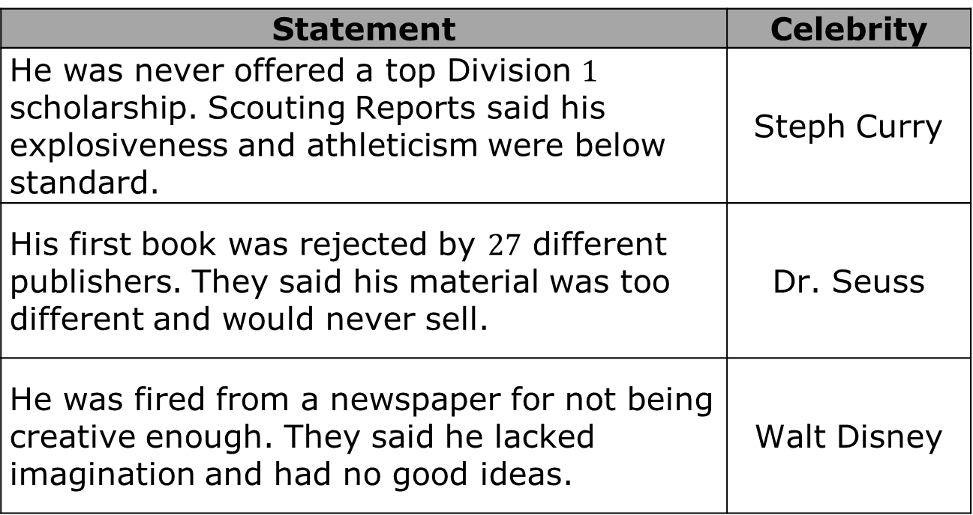
7.4.1 Warm-Up: Growth Mindset
Each statement describes the celebrity indicated.
Statement | Celebrity
He was never offered a top Division $1$ scholarship. Scouting Reports said his explosiveness and athleticism were below standard. | Steph Curry
His first book was rejected by $27$ different publishers. They said his material was too different and would never sell. | Dr. Seuss
He was fired from a newspaper for not being creative enough. They said he lacked imagination and had no good ideas. | Walt Disney
volume 1, pg. 375

Slide 7
How did a growth mindset help these celebrities?
What can you do to maintain a growth mindset if you get frustrated with today’s (or any day’s) lesson to help you keep a growth mindset?
volume 1, pg. 375

Slide 8

Guided Instruction
volume 1, pg. 376

Slide 9
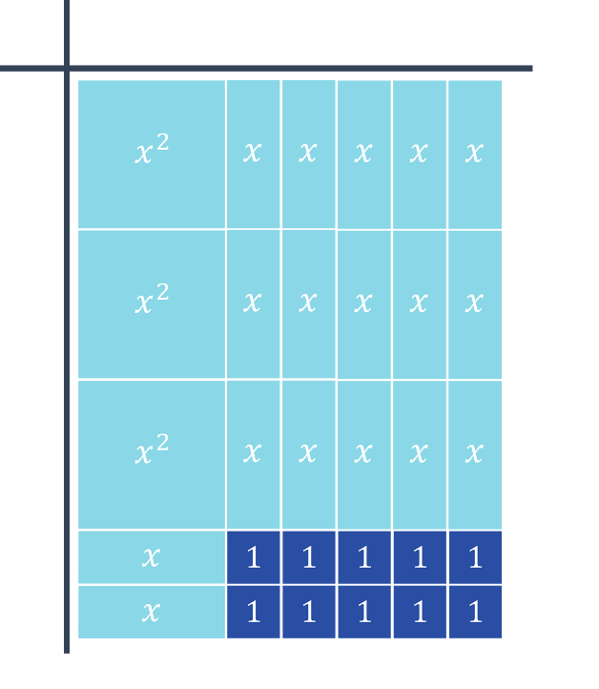
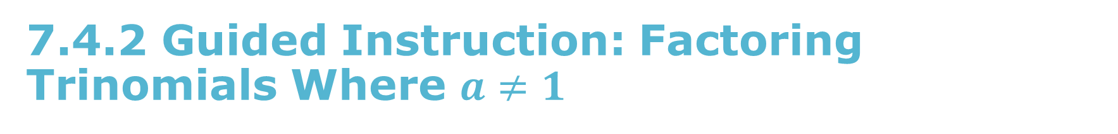
7.4.2 Guided Instruction: Factoring Trinomials Where $a≠1$
Use the algebra tiles to determine the two binomials that are factors of $3x^{2}+17x+10$.
volume 1, pg. 376

Slide 10
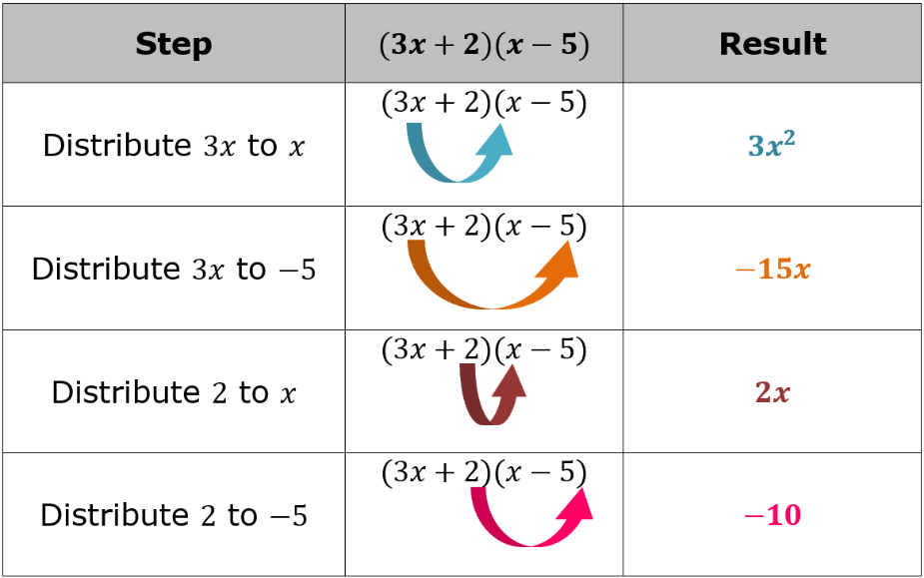

Discuss with your partner any differences you notice between the binomial factors in question 1 and factoring trinomials where $a=1$. Summarize your discussion.
The steps for applying the distributive property to multiply $(3x+2)(x−5)$ are shown.
Based on the results in the table, what is the product of $(3x+2)(x−5)$?
volume 1, pg. 376

Slide 11
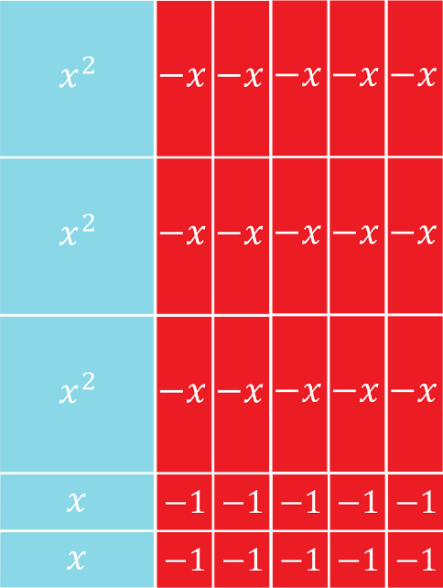

The algebra tiles diagram models the result of $(3x+2)(x−5)$.
Draw a rectangle around $−15x$ in the algebra tiles diagram for $3x^{2}−13x−10$.
volume 1, pg. 377

Slide 12
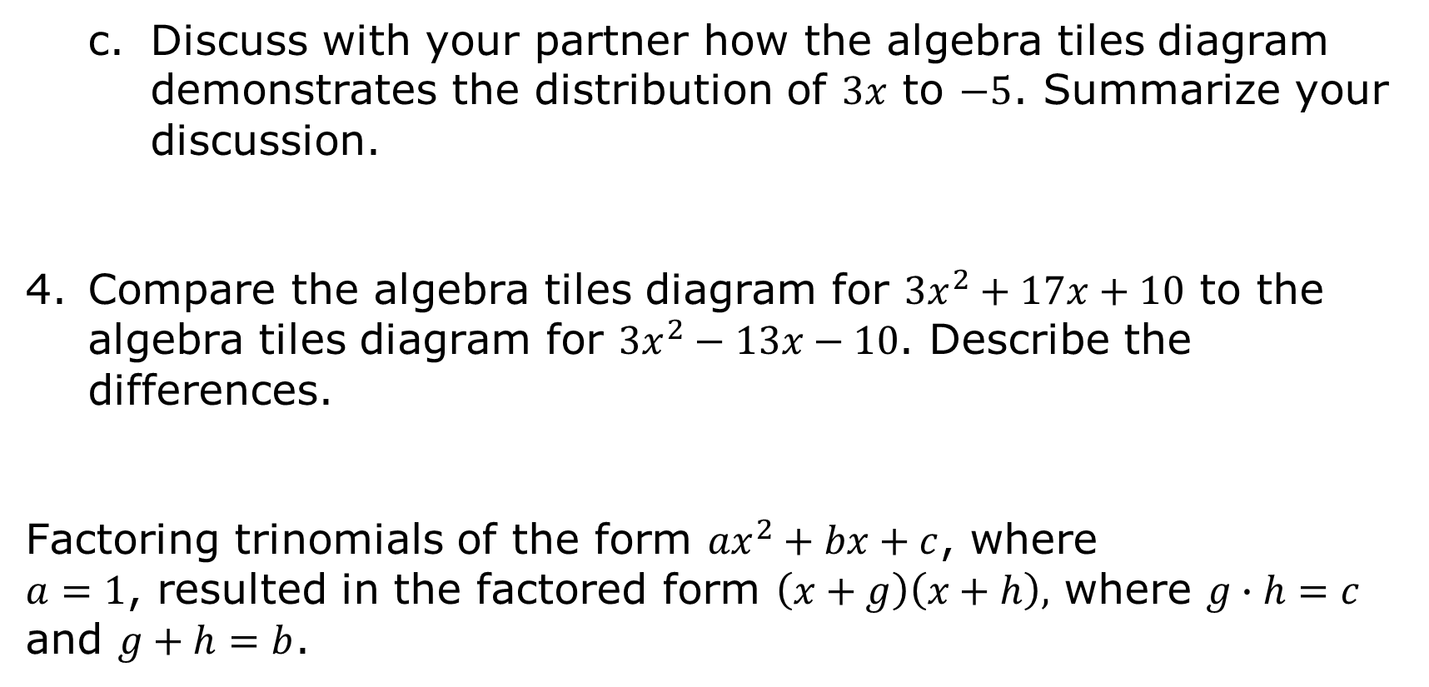
Discuss with your partner how the algebra tiles diagram demonstrates the distribution of $3x$ to $−5$. Summarize your discussion.
Compare the algebra tiles diagram for $3x^{2}+17x+10$ to the algebra tiles diagram for $3x^{2}−13x−10$. Describe the differences.
Factoring trinomials of the form ${ax}^{2}+bx+c$, where
$a=1$, resulted in the factored form $\left(x+g\right)\left(x+h\right),$ where $g∙h=c$ and $g+h=b$.
volume 1, pg. 377

Slide 13
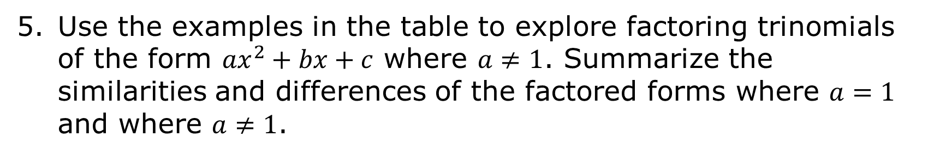
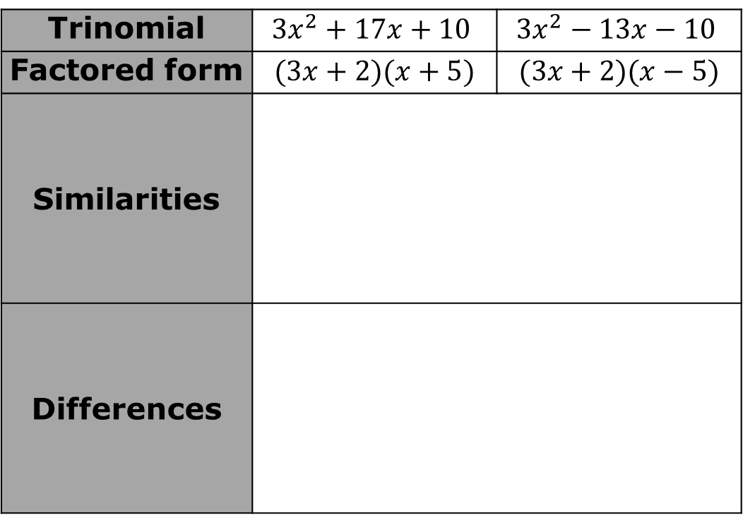
Use the examples in the table to explore factoring trinomials of the form ${ax}^{2}+bx+c$ where $a≠1$. Summarize the similarities and differences of the factored forms where $a=1$ and where $a≠1$.
Trinomial | $$3x^{2}+17x+10$$ | $$3x^{2}−13x−10$$
Factored form | $$(3x+2)(x+5)$$ | $$(3x+2)(x−5)$$
Similarities
Differences
volume 1, pg. 377

Slide 14
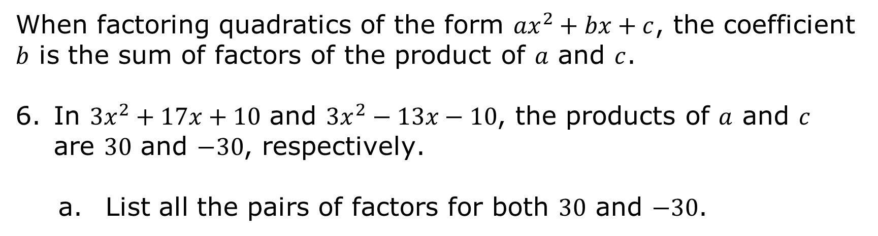
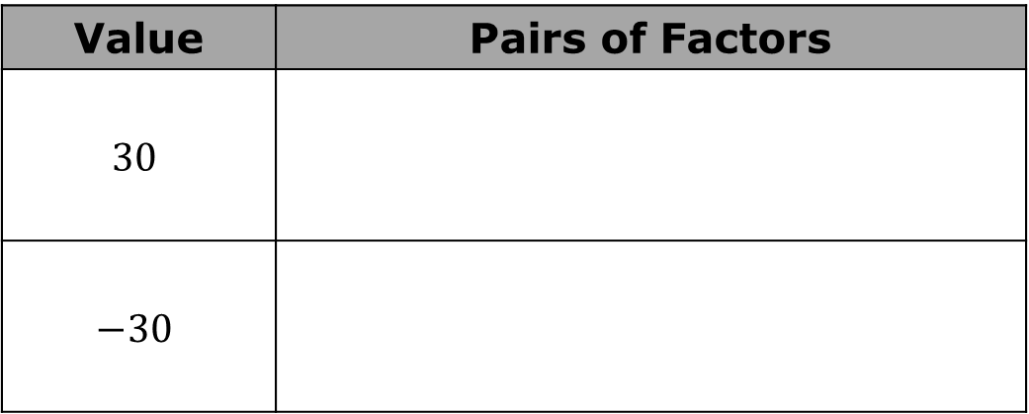
When factoring quadratics of the form ${ax}^{2}+bx+c$, the coefficient $b$ is the sum of factors of the product of $a$ and $c$.
In $3x^{2}+17x+10$ and $3x^{2}−13x−10$, the products of $a$ and $c$ are $30$ and $−30$, respectively.
List all the pairs of factors for both $30$ and $−30$.
Value | Pairs of Factors
$$30$$
$$−30$$
volume 1, pg. 378

Slide 15
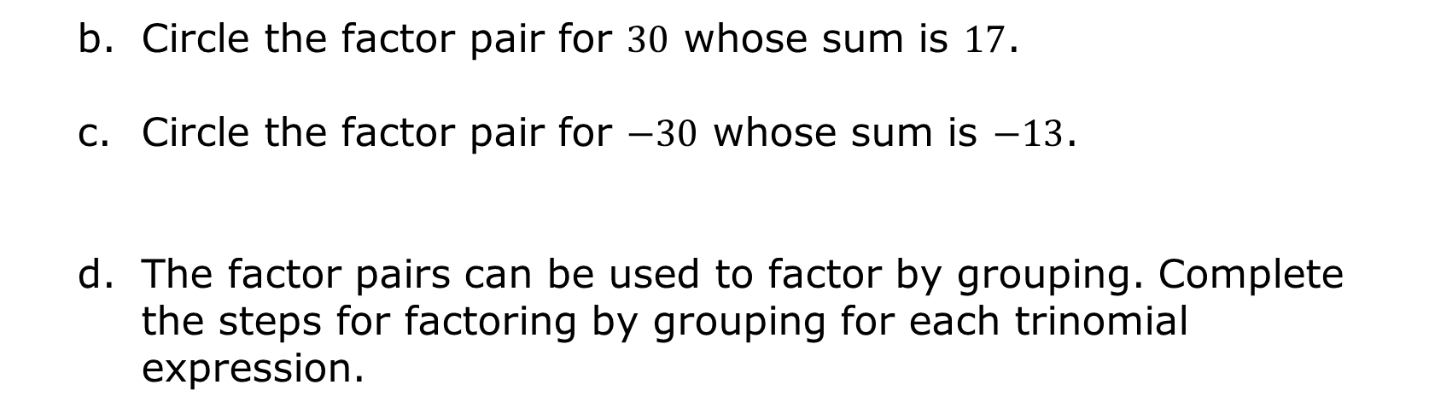
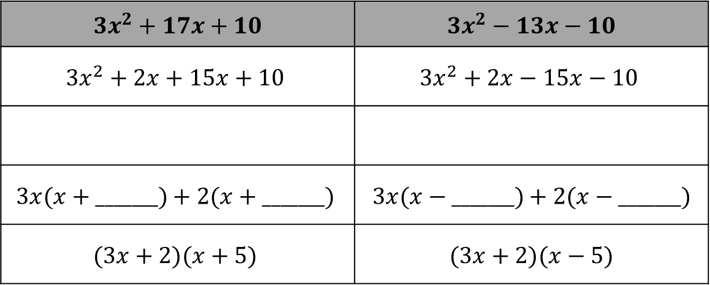
Circle the factor pair for $30$ whose sum is $17$.
Circle the factor pair for $−30$ whose sum is $−13$.
The factor pairs can be used to factor by grouping. Complete the steps for factoring by grouping for each trinomial expression.
$$3x^{2}+17x+10$$ | $$3x^{2}−13x−10$$
$$3x^{2}+2x+15x+10$$ | $$3x^{2}+2x−15x−10$$
$$3x(x+_______)+2(x+_______)$$ | $$3x(x−_______)+2(x−_______)$$
$$(3x+2)(x+5)$$ | $$(3x+2)(x−5)$$
volume 1, pg. 378

Slide 16

Guided Practice
volume 1, pg. 379

Slide 17

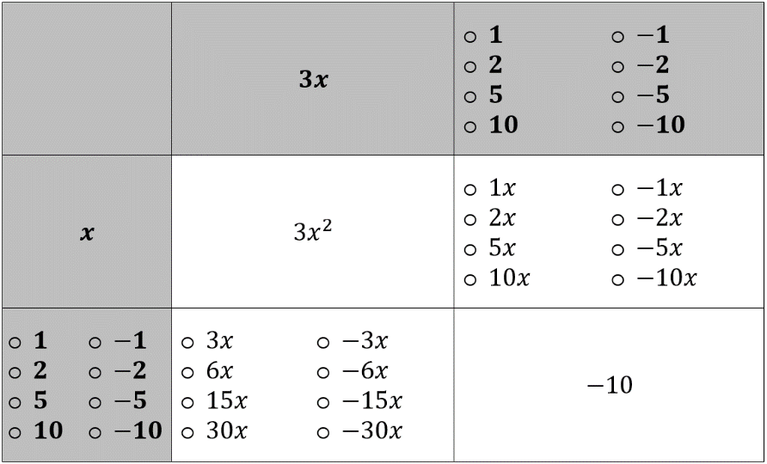
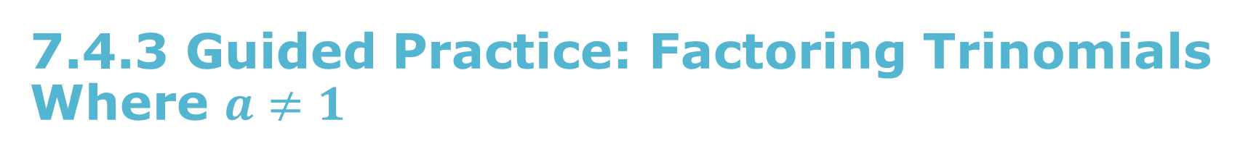
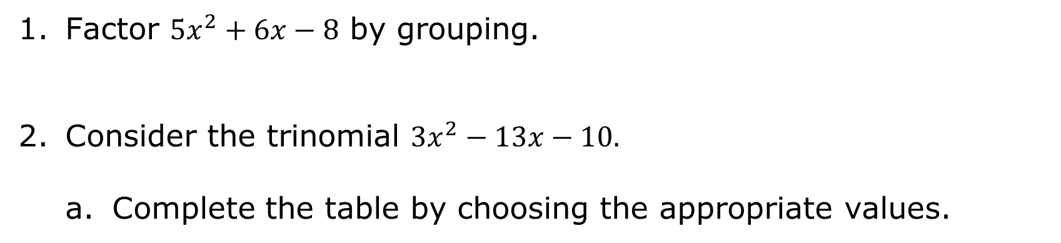
7.4.3 Guided Practice: Factoring Trinomials Where $a≠1$
Factor $5x^{2}+6x−8$ by grouping.
Consider the trinomial $3x^{2}−13x−10.$
Complete the table by choosing the appropriate values.
volume 1, pg. 379

Slide 18
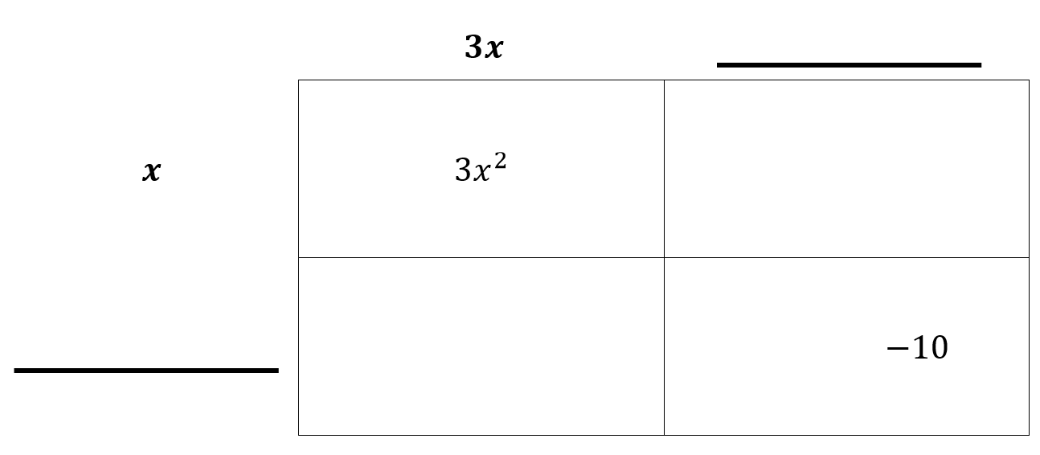
Use the values to complete the area model.
volume 1, pg. 379

Slide 19
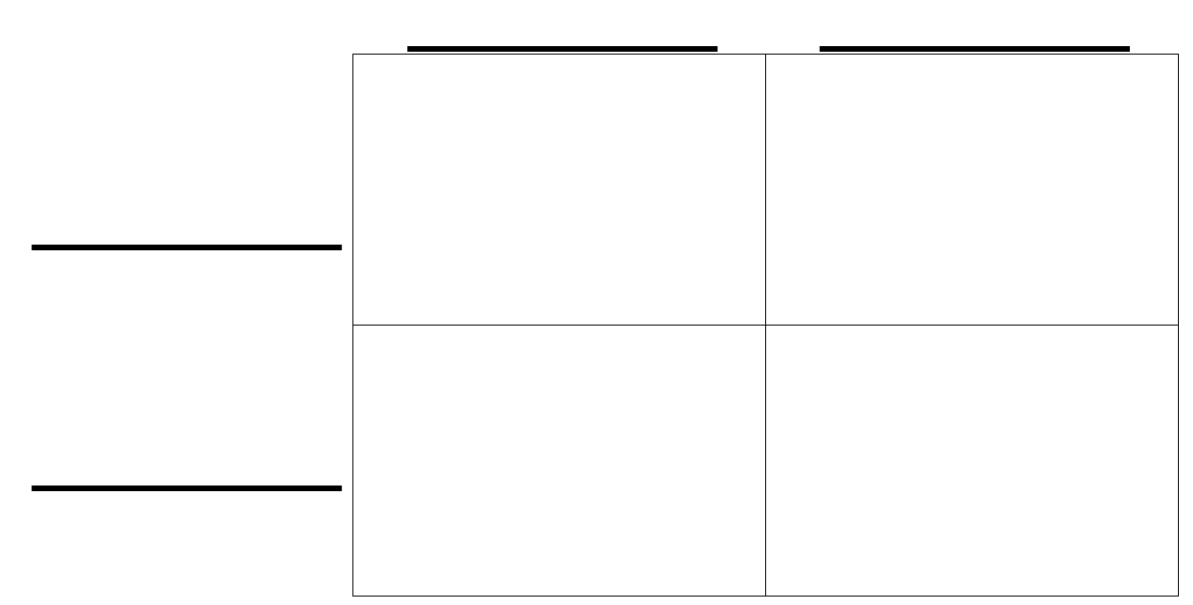
Factor $5x^{2}−3x−8$ using the area model.
volume 1, pg. 380

Slide 20

Try It
volume 1, pg. 380

Slide 21

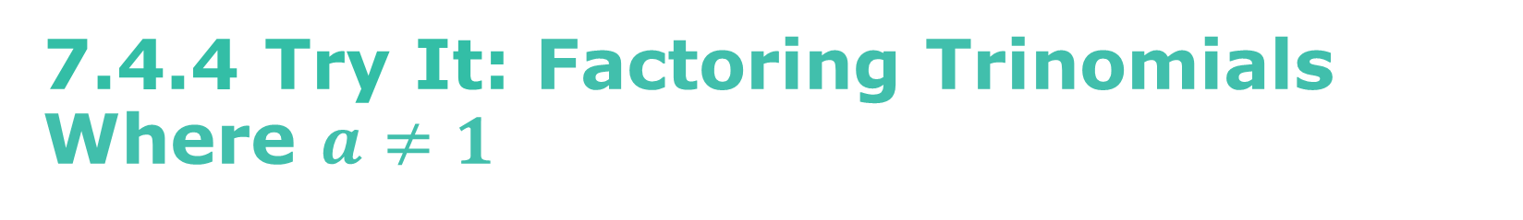
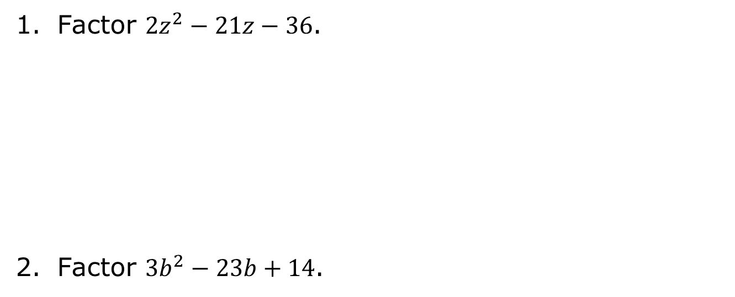
7.4.4 Try It: Factoring Trinomials Where $a≠1$
Factor ${2z}^{2}−21z−36$.
Factor ${3b}^{2}−23b+14$.
volume 1, pg. 380

Slide 22

Your Turn
volume 1, pg. 381

Slide 23

7.4.5 Your Turn!
Consider the quadratic expression.
$$5x^{2}+21x+18$$
Factor using the area model.
Factor by grouping.
volume 1, pg. 381

Slide 24

Wrap-Up
volume 1, pg. 381

Slide 25

7.4.6 Wrap-Up: Reflection
What was the muddiest (most difficult or confusing) point in today’s lesson on factoring trinomials where $a≠1$?
volume 1, pg. 381

